Slide 1

COVID 19’S IMPACT ON AIRPORTS
By Arthur, Jon, and Sonny

Slide 2

A Statistical Overview of COVID’s Impact on Traveling
This project will study how COVID-19 impacted airport traffic numbers based on information in 2020. This data will be compared to data from 2019 as a baseline.

Slide 3

Hypotheses
Traveler numbers have decreased in 2020 compared to 2019 by a statistically significant margin.
Traveler numbers decrease as Covid case numbers increase in a strong negative relationship.
The correlation between traveler numbers and case numbers will be strongest when allowing for a 2 week delay in case numbers affecting travel numbers.
At a state level, traveler numbers will decrease as Case numbers increase as well. There will be noticable differences in how some states are affected, largely contingent on how well state governments reacted to COVID.

Slide 4

First Step
How has COVID affected travel numbers?
What is the baseline?
Use 7 day moving average to analyze data
Initial big drop due to government COVID guidelines
Notes:
The project began with a simple question: How has COVID affected travel numbers? The first step to answering this question is to establish a baseline for travel numbers. We found a dataset from the TSA of traveler throughput data beginning at March 1st 2020 and going until December 1st. This data was paired with a control, data from the same time period in 2019. At the time this data looked great. Looking back though, the data had a large issue, the data points began right as COVID started and traveler numbers dropped quickly. This proved problematic when we began to further explore the data and ask more complex questions. If we had more time, we would try to find data beginning in February 2020.
After establishing a data frame with both 2020 and 2019 traveler number data, we found the 7 day moving average of the data and analyzed how different these numbers were. Graphs showed the data was drastically different. This was further confirmed by a 2 sample t test, which showed that our null hypothesis, that the 2019 and 2020 data was the same, was false.
The next step we took was to explore how COVID case numbers may affect traveler numbers. Before this though, let’s first look at what a moving average is.

Slide 5

Moving Average
An analysis tool to smooth data in times series
Used widely by institutions such as JHU when reporting COVID data
We used 7 day moving average to account for testing capacity and uneven reporting cadence

Slide 6

COVID numbers vs Traveler Numbers
Projected strong negative relationship: higher COVID case numbers means few travelers
Traveler numbers can be affected by other factors as well
And we found other factors have large impact to our analysis
Drastic drop at beginning of March was due to the lockdown
Notes:
Our next step was to see if there was a relationship between traveler numbers and case numbers. We did this by taking New York Times COVID case numbers by state and summed them for nationwide data. We came into the project expecting a strong negative relationship to be found: as COVID numbers went up, traveler numbers should go down. From the beginning we acknowledged that the relationship was not as simple as a direct one. Traveler numbers would be affected a large variety of factors, of which case numbers would be just one. We also acknowledged that the relationship would not be a simple independent, dependent variable relationship. While Case numbers would certainly affect traveler numbers, traveler numbers would also influence case numbers. Looking back, we didn’t realize how large the other factors would be. A major factor is that flying was practically impossible early in the pandemic. Flying was not allowed for the vast majority of people. Flights were cancelled and there were no new flights to many locations. This meant that there was no relationship between the two variables at times like this.

Slide 7

Time Lag: COVID number and Traveler Number
Lag between COVID case number and traveler number
Used time-shift in our analysis to reflect this lag
Proven to be problematic
Notes:
The next question asked is if it takes some time for case numbers to affect traveler numbers to go down. We explored time lag by implementing a time-shift in our data. We ranged from comparing case numbers from 30 days after traveler numbers to 30 days before traveler numbers to find the strongest correlation. We went in expecting case numbers from 14 days before to have the strongest negative relationship with traveler numbers. This proved to be about half right. However, there were massive problems with these analyses.

Slide 8

Time shift problems
7 day moving average and -30 to 30 range shift means meaningful analysis begins at April 7th, which cut off some meaningful data from March to May
this plus the non-COVID factors at the beginning of March made it difficult to establish correlation
Notes:
New issues quickly became apparent besides already existing problems with the correlation between traveler numbers and case numbers. The major problem was a compounding issue of the need to use a 7 day moving average and that the core of our hypothesis was that earlier case numbers would affect later traveler numbers. Our data truly began March 1st and as mentioned earlier, travel numbers cratered shortly after this date. The moving average means we can start analyzing data from March 7th. Time shifting from our range of -30 to 30 means the earliest data we can truly compare begins at April 7th for our outer range, a date far after the largest drops in traveler data. Unfortunately, these problems did not become apparent until near the end of our project and made a large part of this analysis useless, especially considering the useless data was the core of our hypothesis. If we had more time to work on the project, a large portion of this time would be spent evaluating whether or not a meaningful analysis on the correlation between these two variables can even be done and new ways to approach a time shift to find the strongest correlation.

Slide 9

Case Numbers at local level:
State and Airports
Four states:
Massachusetts
Georgia
California
Texas
Five airports
BOS
ATL
LAX
SFO
DF2
Notes:
After looking at nationwide numbers, we decided to take a more focused view and look at the differences between individual states and airports found within them. We first looked at case numbers in California, Texas, Massachusetts, and Georgia. We then compared this data to key airports found within these states: Los Angeles and San Francisco Airports for CA, Dallas Fort Worth for TX, Logan Airport for MA, and Atlanta Airport for GA. We chose these airports because they cover different core criteria in airports. California, the state with the largest population and large population spread, has two major airports and many small ones. Data from LAX and SFO give a small glance into CA COVID data. DFW in Texas is similar in nature. The other two airports follow the other extreme. Logan Airport is the only big airport in MA. Most people from MA fly from Logan. Atlanta airport exceeds Logan in this respect. Atlanta Airport is one of the biggest flight hubs in the country. It not only draws in all of Georgia, but also people from other states. These 5 airports in 4 states should give a fairly comprehensive view altogether. These states also offer a glance at the difference between Northern and Southern states in dealing with COVID.
The first steps taken here were to pick out our states and airports. After selecting them we found the case rate of change, how many new cases there are each day. We also applied the 7 day moving average to this data. We then graphed out the data, for both total cases and case rate of change, and compared states against each other. However, this data is flawed as it does not account for differences in population size or in population density. A much more complete analysis would also cover both metrics with respect to population. We later graphed both total cases and case rate of change again with respect to population and compared states against each other.

Slide 10

Data Exploration and Analysis

Slide 11
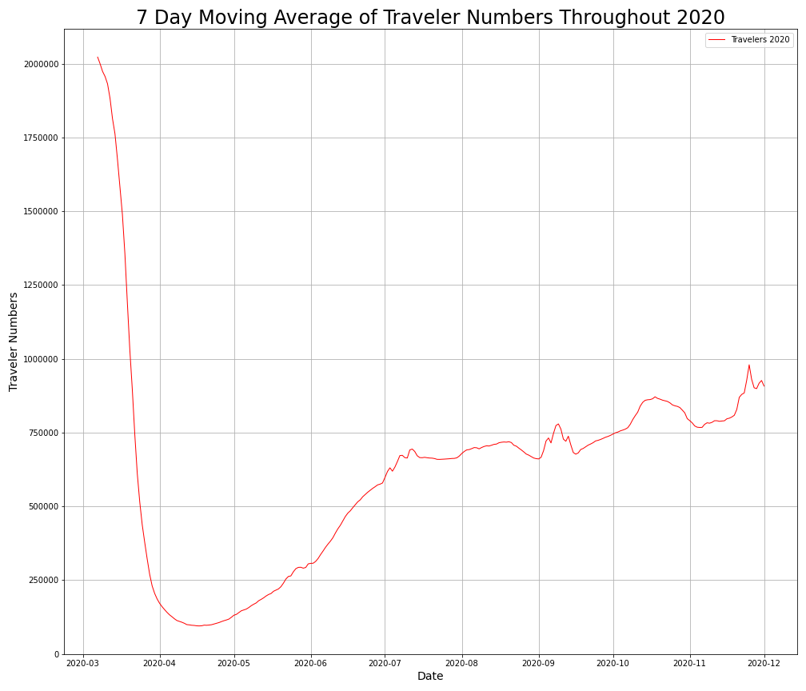
2020 Number of Travelers
The change in the behavior of passengers following the COVID-19 crisis, travel restrictions and the ensuing economic crisis have resulted in a dramatic drop in demand for airline services.

Slide 12
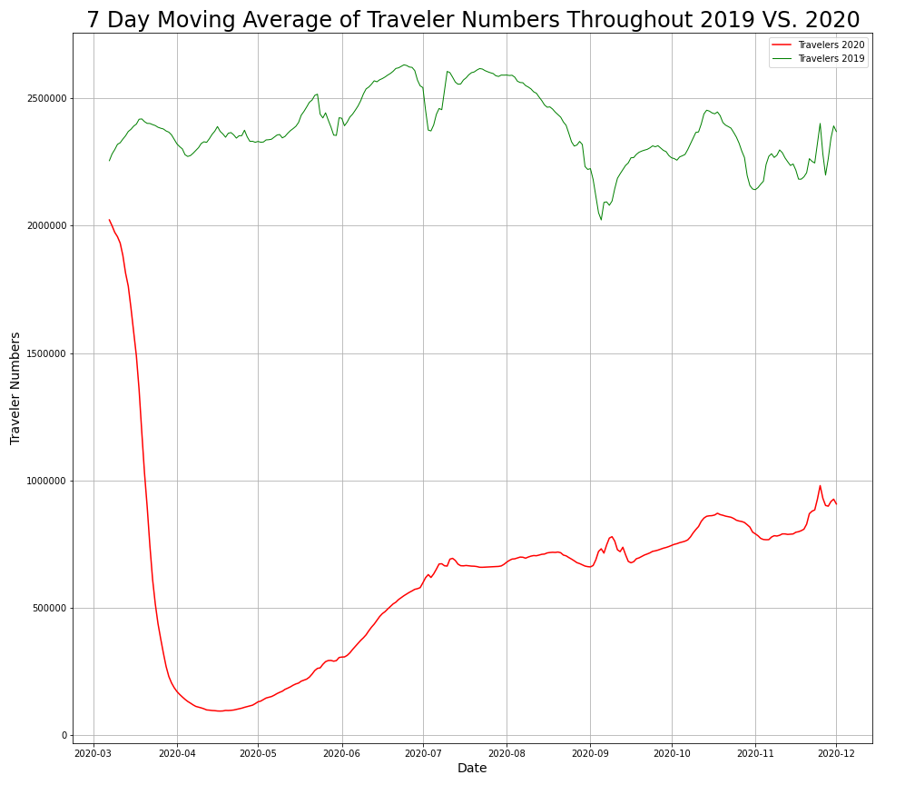
Traveler Numbers 2020 vs 2019 on the Same Date
As can be seen visually, 2019 traveler numbers looked drastically different from 2020. Numbers in 2020 dipped as low as 10% of numbers in 2019 at certain times. After an initial large drop off, traveler numbers have continued to slowly climb back towards the norm. Our two sample t-test disproved the null hypothesis that the two datasets were the same

Slide 13
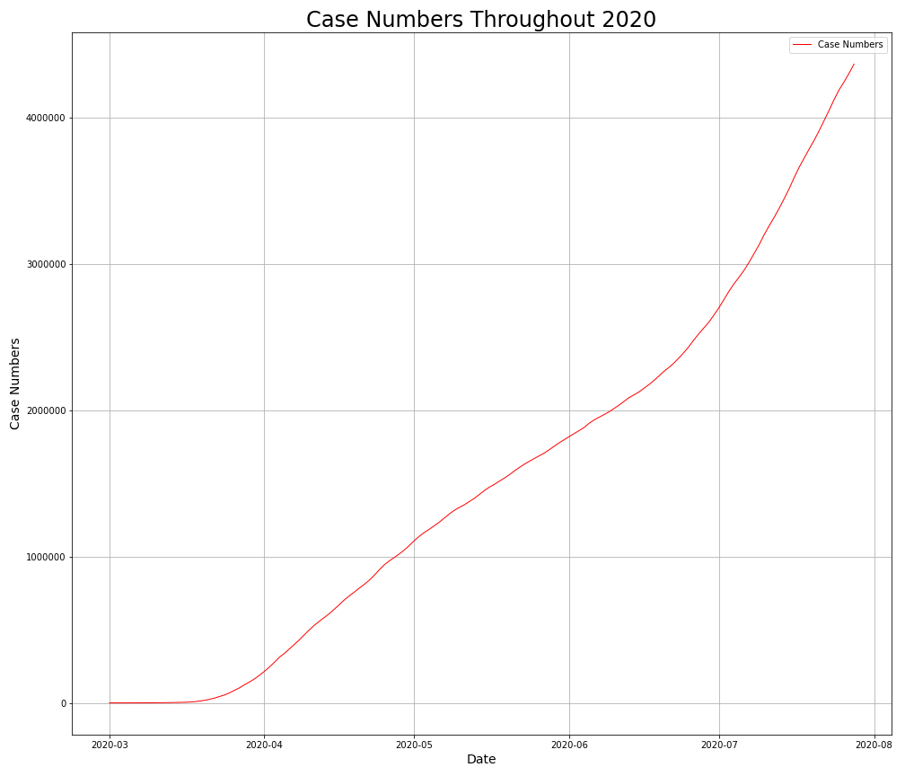
Nationwide Case Numbers
Case numbers in 2020 nationwide have been increasing steadily at a mostly even rate since late June. The slope gets steeper following July at a faster rate.

Slide 14
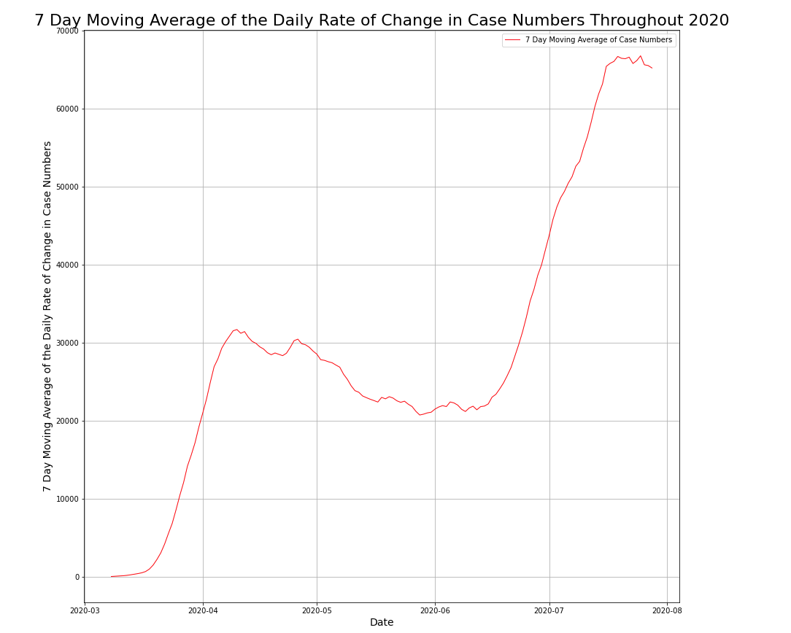
Nationwide Cases Moving Rate of Change Average
This graph better shows how case numbers have changed throughout the pandemic. This data is a much better comparator than total cases for traveler data. Total cases does not account for people who have recovered from COVID. Case rate of change is a better tracker for how many people have COVID at any particular time. As you can see in the graph, case rate climbed steadily from mid March until mid April, slowly declined until mid June, and climbed steadily again from there.

Slide 15
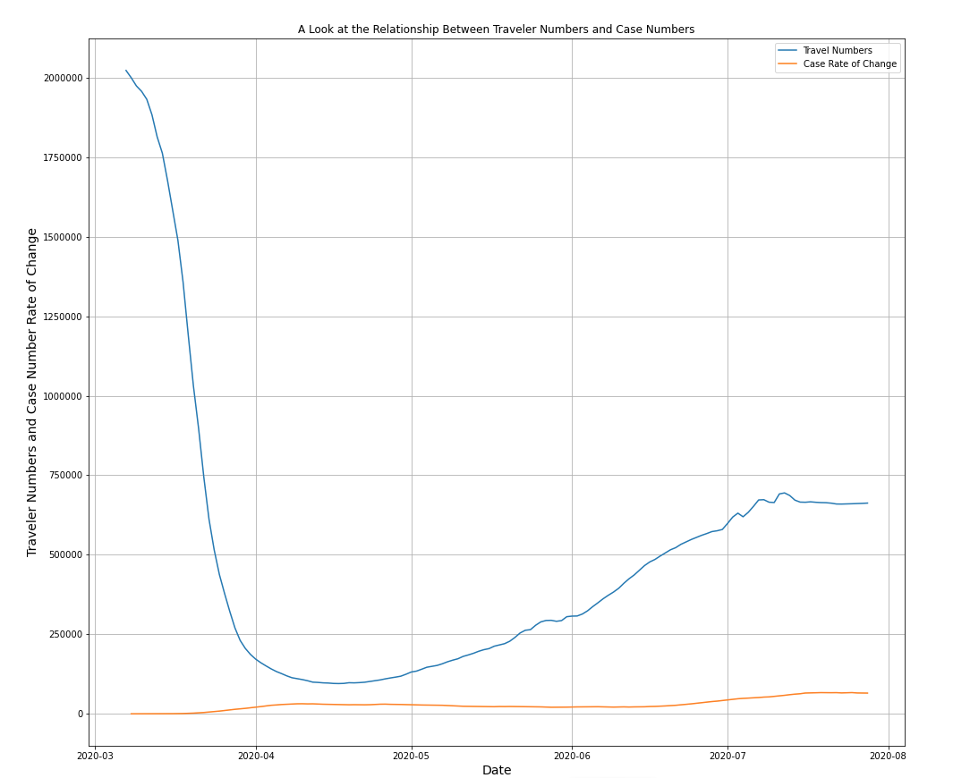
Relationship Between Case Numbers ROC and Traveler Numbers
Because of the large difference in y axis numbers, it’s hard to see how traveler numbers change as the rate of change in case numbers increases. Let’s see if we can fix that with the twinx code from earlier.

Slide 16
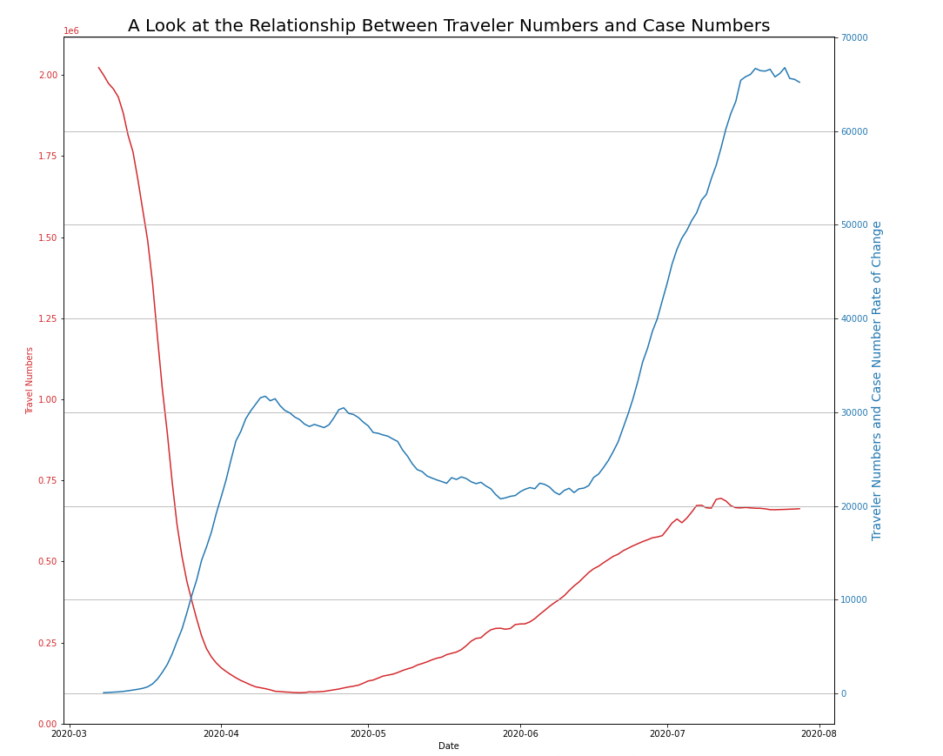
Relationship Between Case Numbers ROC and Traveler Numbers
The correlation between the data without any time lag is -.2138, a negative relationship, but certainly not a strong one. The graph above shows the lines at similar scales together. The early big drop in traveler numbers corresponds with the rise in case numbers from March/April, but traveler numbers rise as case numbers rise as well later on.

Slide 17
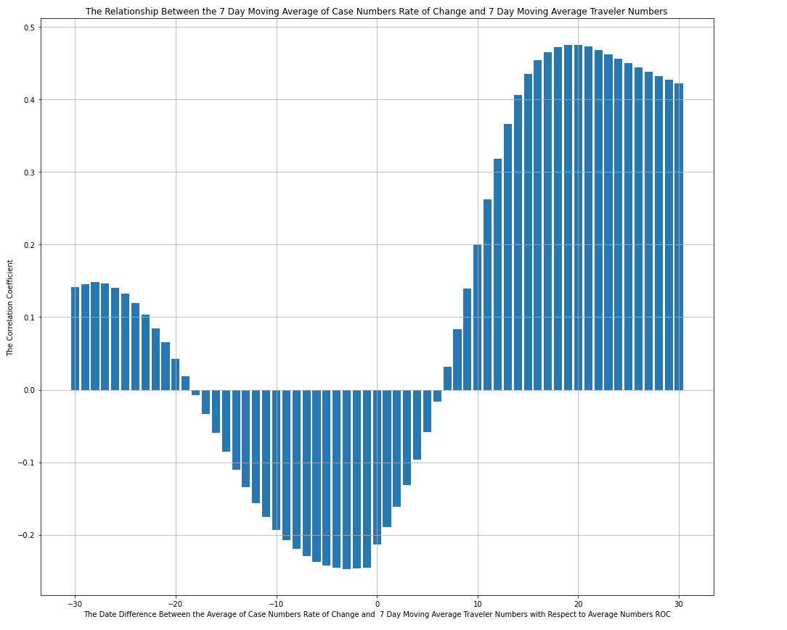
Correlation
After our for loop to find best correlation, here are all of the different correlations found at different time shifts. The strongest correlation was found to be at 20, so comparing data from March 27th case numbers to March 7th traveler numbers. The correlation was .4757, a respectable correlation, but not the negative one we expected. The later months having both traveler numbers rise and case numbers rise at the same time is why this correlation is positive. To get a negative correlation we need to narrow down our dates to primarily cover the drop in March/April.

Slide 18
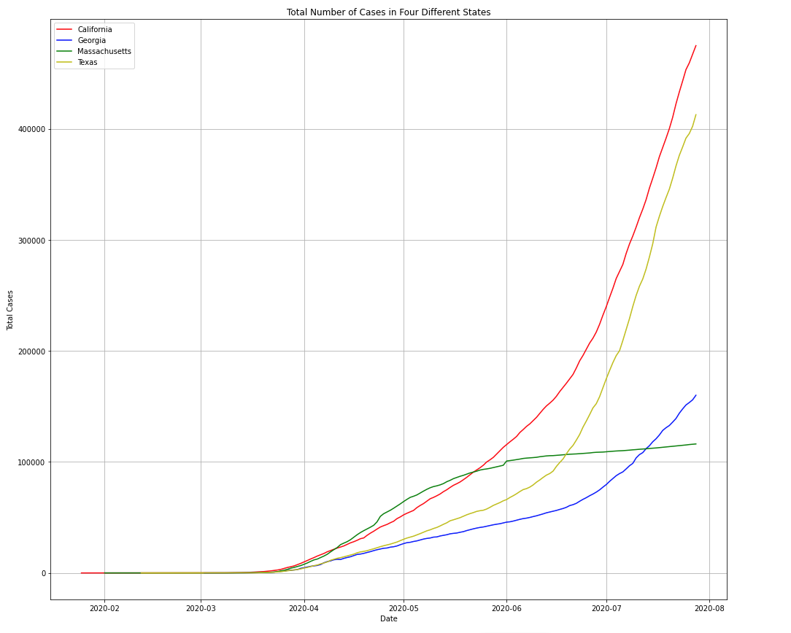
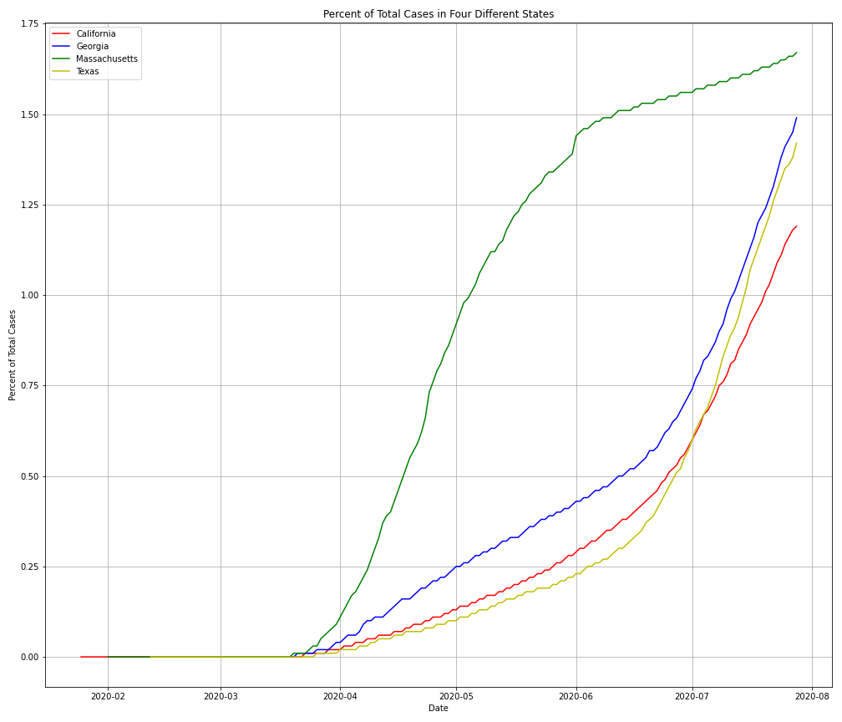
2020 Number of Cases vs Number of Cases by Population
On the left, we have total number of cases in our 4 different states. On the right, we have the same but accounting for population. On the left, it looks like Massachusetts gets an early start to COVID compared to the other states, but not by a large lead. On the right, this lead looks gigantic. On the left, California and Texas have way more total cases than Massachusetts or Georgia. On the right, by population Massachusetts has the most cases per person and Georgia has more than both Texas and California as well.

Slide 19
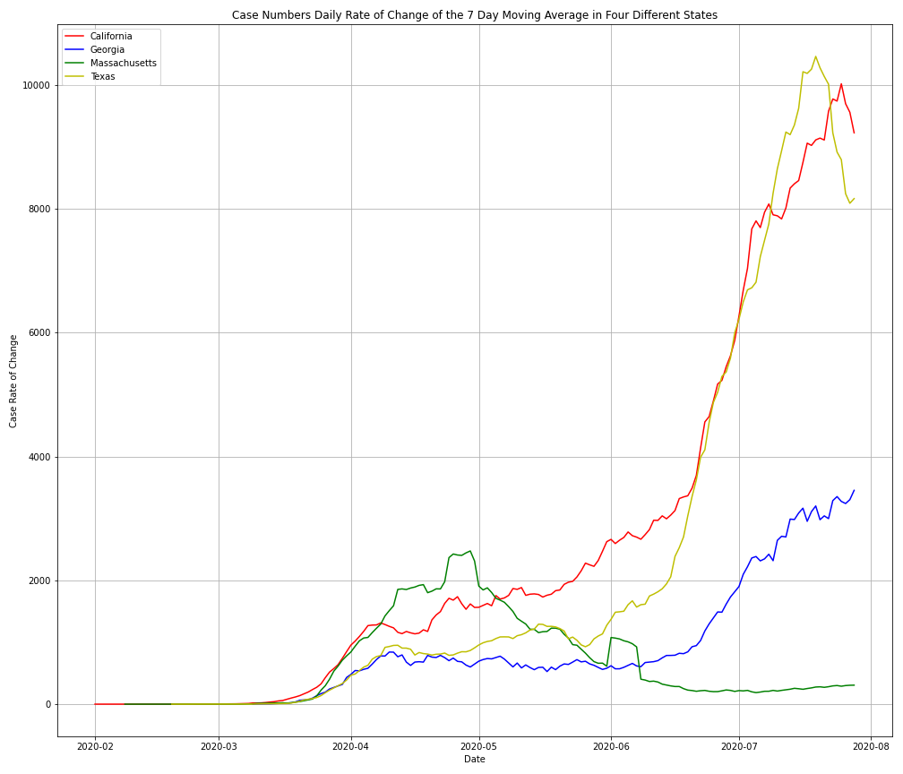
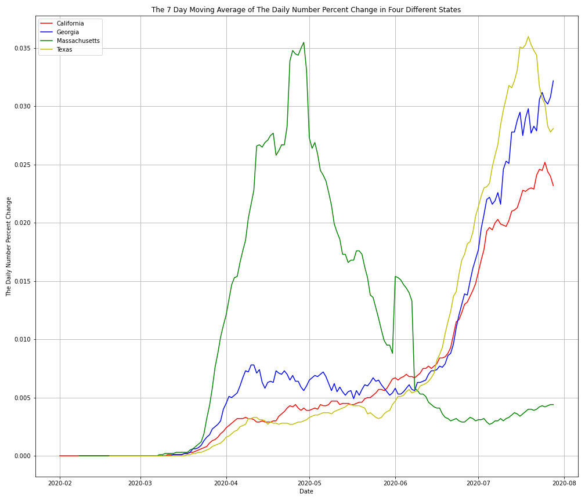
Case Rate of Change by State Vs. Case Percent Rate of Change by State
Here we have a look at case rate of change vs. case rate of change given population. In the left graph of rate of change, Massachusetts takes a small lead but quickly trends downwards to the least amount of cases, while Texas and California take over. Georgia has a increase at a similar time as California and Texas, but much smaller. The right graph with respect to population changes the narrative a lot. The Massachusetts spike is massive and spikes way earlier than the other 3 states. Georgia looks about the same as California and Texas. Different context can change data in massive amounts. It is important to understand the data through different lenses as it can tell different stories.

Slide 20
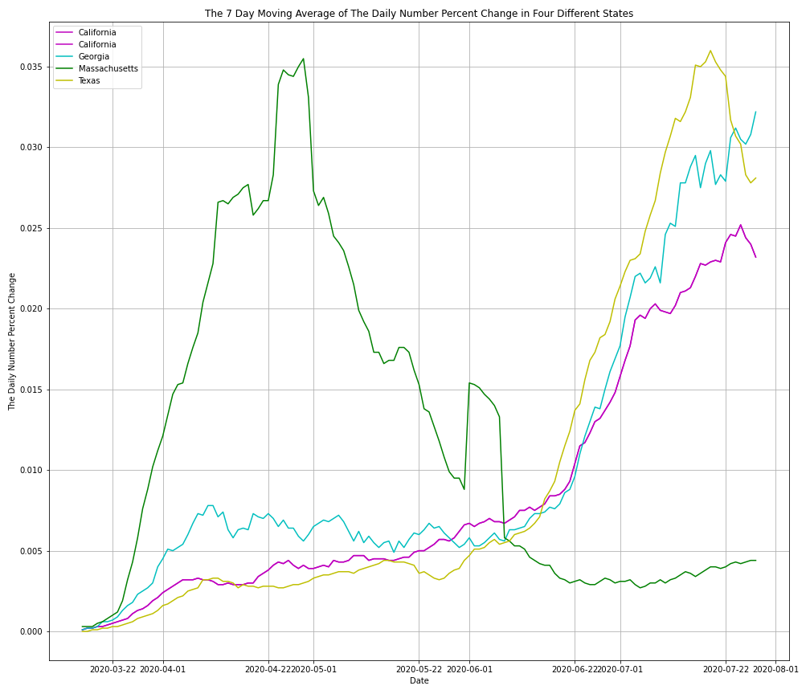
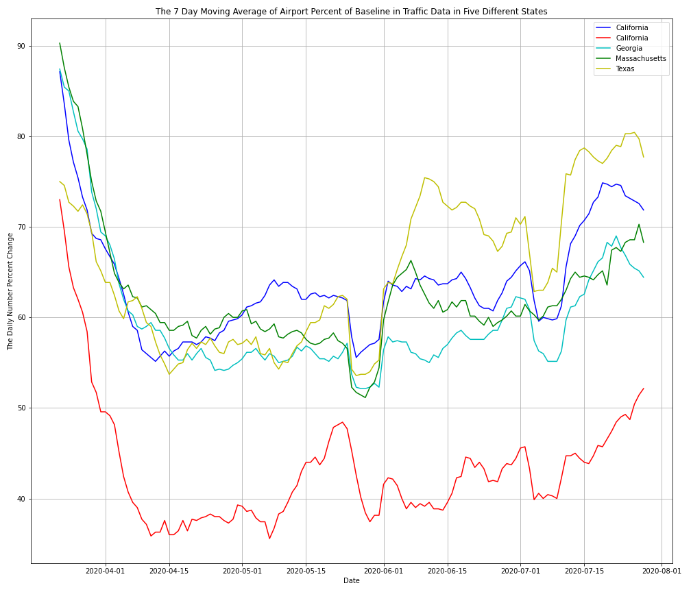
Airport Traffic Data vs. State Case ROC in Case Numbers Relationship
Here we can compare the change in case numbers with respect to population percentage to airport traffic with respect to percent of baseline. We expected to find strong negative correlations here. We ended up finding a correlations of .3654 for LAX and CA, .0703 for SFO and CA, -.37123 for BOS and MA, .669 for DFW and TX, and .1048 for ATL and GA.

Slide 21


Slide 22
Closing Analysis
Let’s take a look back at our hypotheses.
Traveler numbers have decreased in 2020 compared to 2019 by a statistically significant margin.
We examined this data through graphs and found this statement to be true. We applied a 2 sample t test to the null hypothesis and found that the samples were significantly different from each other. We adequately proved our hypothesis here.
Traveler numbers decrease as Covid case numbers increase in a strong negative relationship.
The correlation between traveler numbers and case numbers will be strongest when allowing for a 2 week delay in case numbers affecting travel numbers.
These hypotheses proved to be a lot more difficult. These questions were fundamentally flawed to begin with and we used too much data in a time series to answer them well. The answers we found conflicted with our hypotheses. If we had more time on the project, we could get better answers, but we would never achieve good results while only looking at 2 variables. We would need to reevaluate our questions.
At a state level, traveler numbers will decrease as Case numbers increase as well. There will be noticable differences in how some states are affected, largely contingent on how well state governments reacted to COVID.
This last question met with middling success. We should have targeted more questions looking at the differences in states and how COVID numbers differed between them. Our correlations suffered the same setbacks as they did at a national level. Using a smaller time period would have led to better results for the questions we did ask. Accounting for more variables would have also improved our results. Looking at states helped us learn the most about approaching data in the future.

Slide 23
Closing Thoughts
We learned a lot from this project. A few key things to take away from it were:
We became more experienced with the methods we were taught.
We learned a few new methods to manipulate and interpret data.
One really needs to understand the data before using it to solve problems. Try looking at the data through different lenses and points of view.
One also really needs to understand the questions being asked. How can you effectively answer the questions? Do you have the data to support it?
Always find out what data types you are working with. Adapt these data types to your own needs.
More data points is not always better. Larger sample size makes data more accurate for some questions, sometimes more data clouds your results and prevents you from obtaining the answers from questions you asked.
Use succinct and easily understood variable names.
Annotate code well so anyone can understand what the code does. Keep notes succinct if possible.

Slide 24
Data Sources
https://www.tsa.gov/coronavirus/passenger-throughput?page=1
This source was used to obtain traveler throughput numbers obtained by the TSA over a period of 9 months, from March 1st to December 1st, of both 2019 and 2020.
https://www.kaggle.com/roche-data-science-coalition/uncover
The New York Times COVID case numbers were used from this database collection. This dataset was used to obtain nationwide numbers, as well as a few select states. The data spans from early February to late July.
https://www.kaggle.com/terenceshin/covid19s-impact-on-airport-traffic
This source was used to obtain airport traffic data as a percentage of traffic volume from a baseline period of February 1st to March 15th 2020, before COVID.
https://worldpopulationreview.com/states
This source was used for population data in the 4 states used for state view metrics.

Slide 25


Slide 26

THANK YOU

